Slide 1
L6 Imitation Learning
Z. Gu 2020

Slide 2
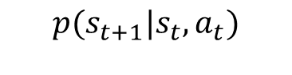
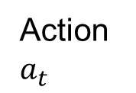
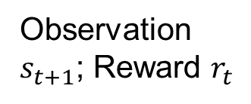
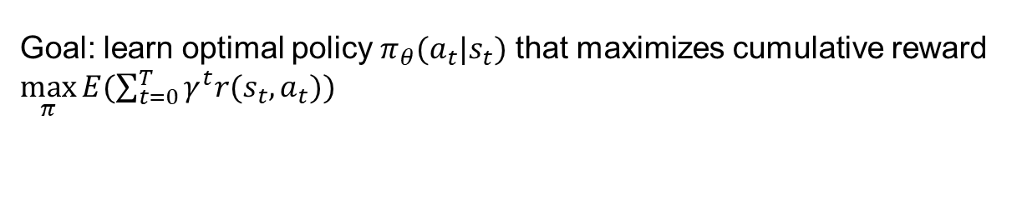
Reinforcement Learning (RL)
The RL problem: find the optimal policy given the reward function.
Sometimes loss function is used, defined as negative of reward function, so minimizing loss is equivalent to maximizing reward.
$${p(s}_{t+1}|s_{t},a_{t})$$
Environment
Action $a_{t}$
Observation $s_{t+1}$; Reward $r_{t}$
RL Agent
Goal: learn optimal policy $π_{θ}(a_{t}|s_{t})$ that maximizes cumulative reward $\max_{π}{E(\sum_{t=0}^{T}{γ^{t}r(s_{t},a_{t})}) }$
Notes:
Policy: State to action

Slide 3
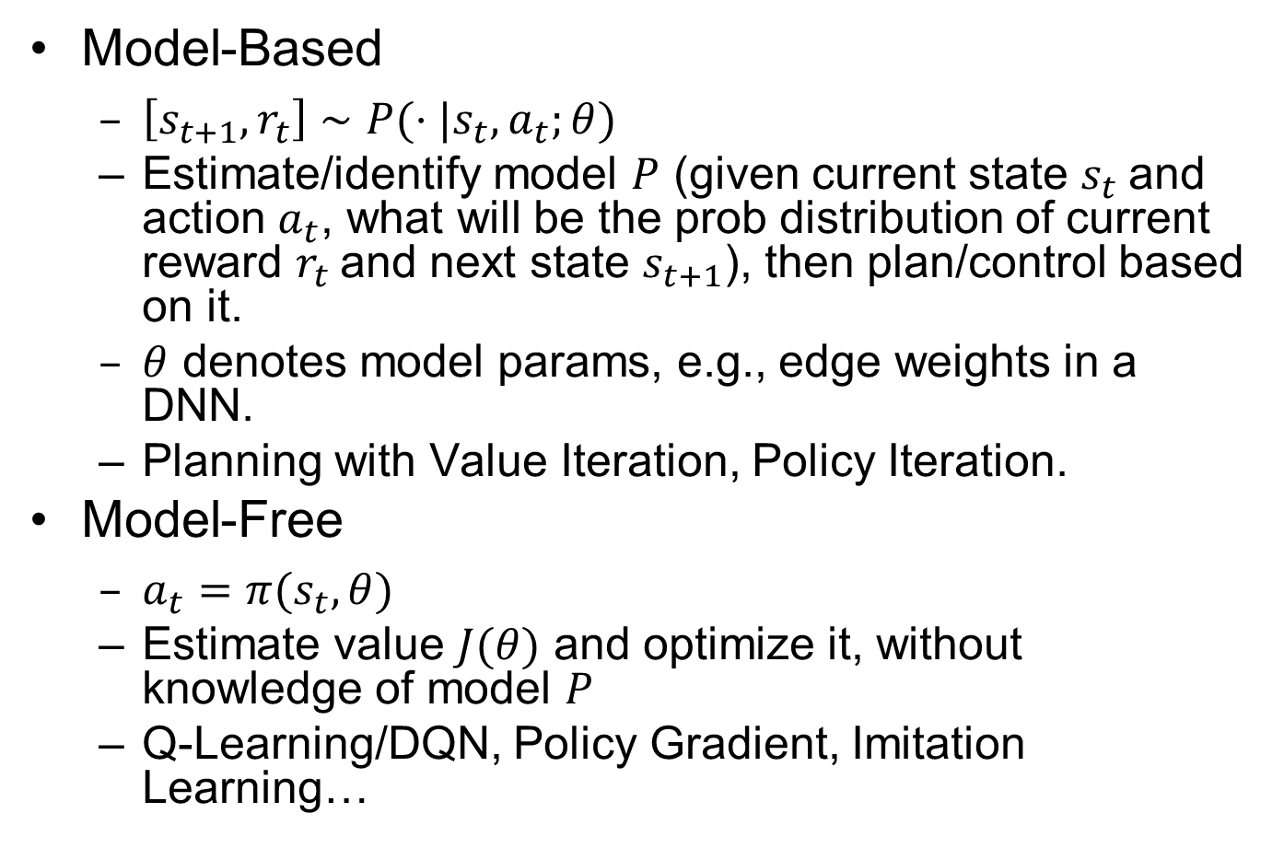
Model-Based vs. Model-Free RL
Model-Based
$\left[s_{t+1},r_{t}\right]∼P(⋅|s_{t},a_{t};θ)$
Estimate/identify model $P$ (given current state $s_{t}$and action $a_{t}$, what will be the prob distribution of current reward $r_{t}$and next state $s_{t+1}$), then plan/control based on it.
$θ$ denotes model params, e.g., edge weights in a DNN.
Planning with Value Iteration, Policy Iteration.
Model-Free
$a_{t}=π(s_{t},θ)$
Estimate value $J(θ)$ and optimize it, without knowledge of model $P$
Q-Learning/DQN, Policy Gradient, Imitation Learning…
Notes:
MPC is model-based; PID can be model-based or model-free

Slide 4
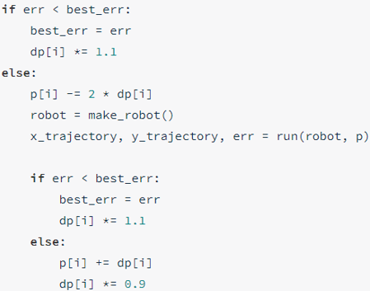
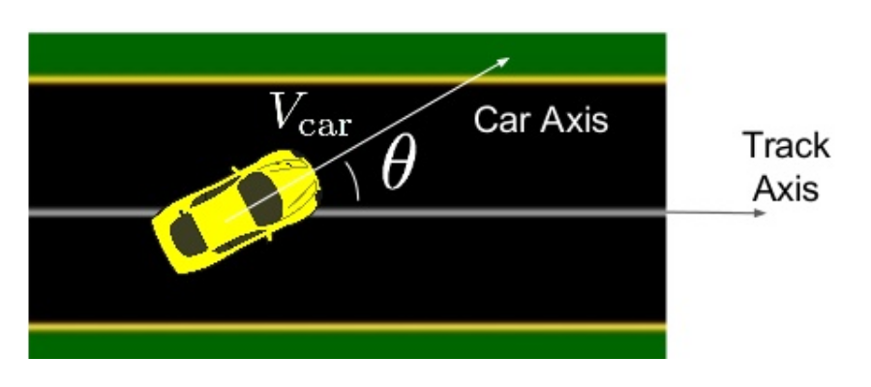
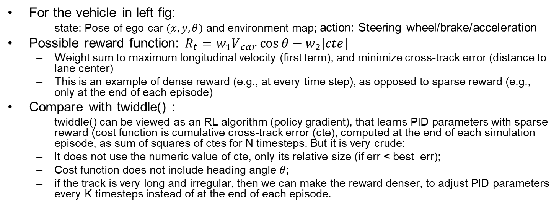
RL Reward Function
For the vehicle in left fig:
state: Pose of ego-car $(x,y,θ)$ and environment map; action: Steering wheel/brake/acceleration
Possible reward function: $R_{t}​=w_{1}V​_{car}\cos{θ}−​w_{2}\left|cte\right|​$
Weight sum to maximum longitudinal velocity (first term), and minimize cross-track error (distance to lane center)
This is an example of dense reward (e.g., at every time step), as opposed to sparse reward (e.g., only at the end of each episode)
Compare with twiddle() :
twiddle() can be viewed as an RL algorithm (policy gradient), that learns PID parameters with sparse reward (cost function is cumulative cross-track error (cte), computed at the end of each simulation episode, as sum of squares of ctes for N timesteps. But it is very crude:
It does not use the numeric value of cte, only its relative size (if err < best_err);
Cost function does not include heading angle $θ$;
if the track is very long and irregular, then we can make the reward denser, to adjust PID parameters every K timesteps instead of at the end of each episode.
twiddle()
Ben Lau, Quantitative Researcher, Hobbyist, at MLconf NYC 2017
Notes:
PID controller is used to track a fixed circular path
Intuitive reward function: $R_{t}=V_{car}\cos{θ}$
maximum longitudinal velocity
Sometimes need to do “reward function hacking” to find one that works well, e.g., $R_{t}​=V​_{car}\cos{θ}−V_{car}​​​sin⁡θ−V​_{car}​\left|cte\right|​$
$$V_{car}​​​sin⁡θ$$

Slide 5
RL Reward Function Issues
RL can be very effective, provided that a suitable reward function is available.
Bad reward function leads to undesirable behavior
Suppose you design a vacuum cleaner to maximize reward function defined as “cumulative amount of dirt sucked in”. The vacuum cleaner may learn to repeatedly spit out and suck in the same pile of dirt!
For AD in realistic environment, the goal is to reach destination with minimum time, while avoiding accidents. But how to encode this into a reward function?
“A great reward function can help you better optimize your reinforcement learning model. In AWS DeepRacer, the reward function is written in Python code, and uses different input parameters to help encourage good behavior and disincentivize poor behavior. There’s no single right answer for which parameters to include in your reward function, and your best reward function will likely require a lot of experimentation.” from AWS DeepRacer MOOC.
https://classroom.udacity.com/courses/ud014/
Notes:
State: Position of ego-car and environment (static and dynamic obstacles)
Action: Steering wheel/brake/accelerate

Slide 6
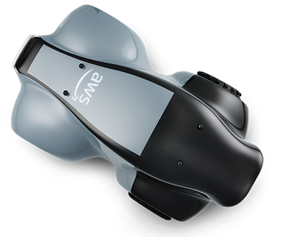
Amazon DeepRacer
Amazon Web Services (AWS) launched DeepRacer in 2018 for training AD algorithms with RL
https://aws.amazon.com/deepracer/
You can train RL algorithm in the simulator on AWS cloud, but it costs money after some free time.
They hold competitions, both online and in real-world. 1/10th scale race car costs USD $349.

Slide 7
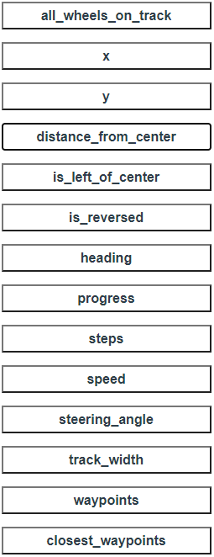
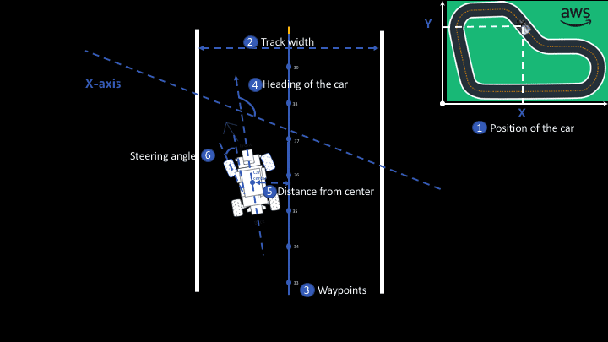
Params for Writing Reward Function
Notes:
Writing a Reward Function

Slide 8
Example Reward Function
def reward_function(params):
'''Example of penalize steering, which helps mitigate zig-zag behaviors'''
# Read input parameters
distance_from_center = params['distance_from_center']
track_width = params['track_width']
steering = abs(params['steering_angle']) # Only need the absolute steering angle
# Calculate 3 markers that are at varying distances away from the center line
marker_1 = 0.1 * track_width
marker_2 = 0.25 * track_width
marker_3 = 0.5 * track_width
# Give higher reward if the agent is closer to center line and vice versa
if distance_from_center <= marker_1:
reward = 1
elif distance_from_center <= marker_2:
reward = 0.5
elif distance_from_center <= marker_3:
reward = 0.1
else:
reward = 1e-3 # likely crashed/ close to off track
# Steering penalty threshold, change the number based on your action space setting
ABS_STEERING_THRESHOLD = 15
# Penalize reward if the agent is steering too much
if steering > ABS_STEERING_THRESHOLD:
reward *= 0.8
return float(reward)
A more realistic and complex reward function: https://www.middleware-solutions.fr/2019/08/14/an-introduction-to-aws-deepracer

Slide 9
Imitation Learning (IL)
IL is useful when it is easier for an expert to demonstrate the desired behavior, rather than to specify a reward function for RL to learn the policy.
e.g., for Automated Driving in a realistic environment, the reward function would be a huge complex function involving everything in the environment
Requires access to an expert, either offline (driving data logs) or online (query-on-demand)
Also called Learning from Demonstrations.
IL variants:
Learn to mimic the expert’s policy
Behavior Cloning
Direct Policy Learning
Learn the expert’s value function
Inverse Reinforced Learning

Slide 10
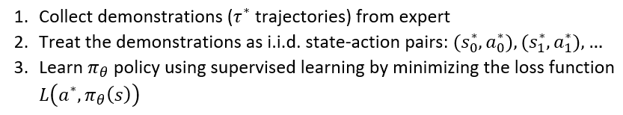
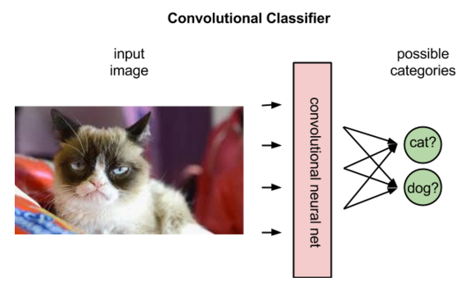
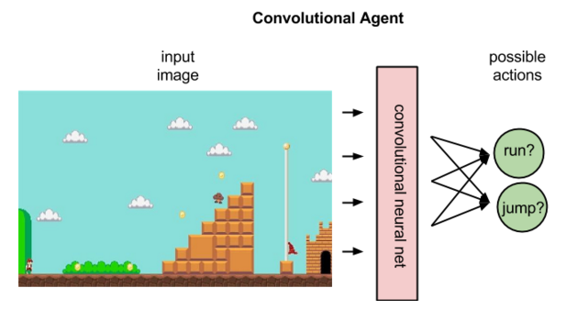
Behavior Cloning (BC)
Behavior Cloning (BC) is a form of Supervised Learning (SL), where an agent is trained to perform a task from demonstrations by learning a mapping (e.g., a CNN) between states (input data) and actions (labels).
https://pathmind.com/wiki/deep-reinforcement-learning

Slide 11
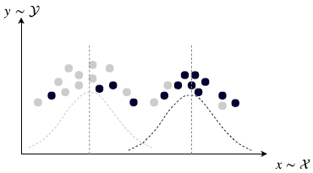
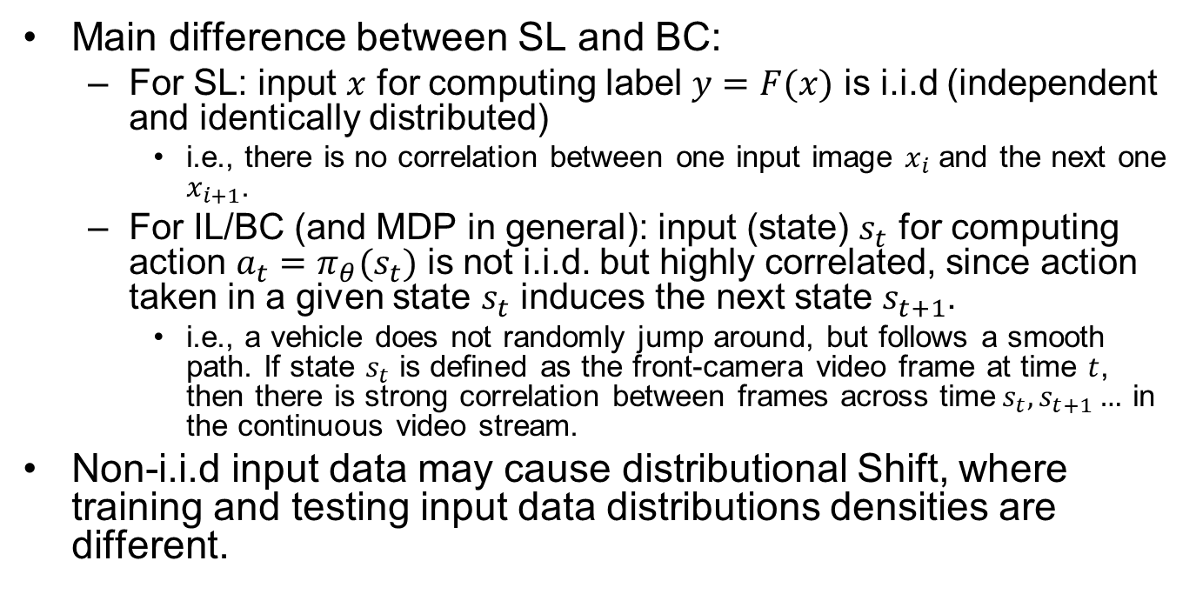
SL vs. BC
Main difference between SL and BC:
For SL: input $x$ for computing label $y=F(x)$ is i.i.d (independent and identically distributed)
i.e., there is no correlation between one input image $x_{i}$ and the next one $x_{i+1}$.
For IL/BC (and MDP in general): input (state) $s_{t}$ for computing action $a_{t}=π_{θ}(s_{t})$ is not i.i.d. but highly correlated, since action taken in a given state $s_{t}$ induces the next state $s_{t+1}$.
i.e., a vehicle does not randomly jump around, but follows a smooth path. If state $s_{t}$ is defined as the front-camera video frame at time $t$, then there is strong correlation between frames across time$s_{t},s_{t+1}…$ in the continuous video stream.
Non-i.i.d input data may cause distributional Shift, where training and testing input data distributions densities are different.
https://pathmind.com/wiki/deep-reinforcement-learning
Notes:
(sequence of state-action pairs)

Slide 12
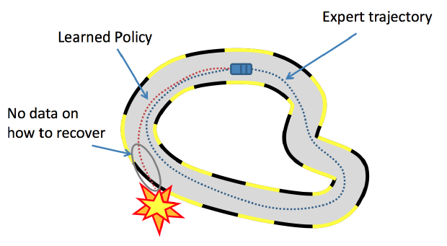
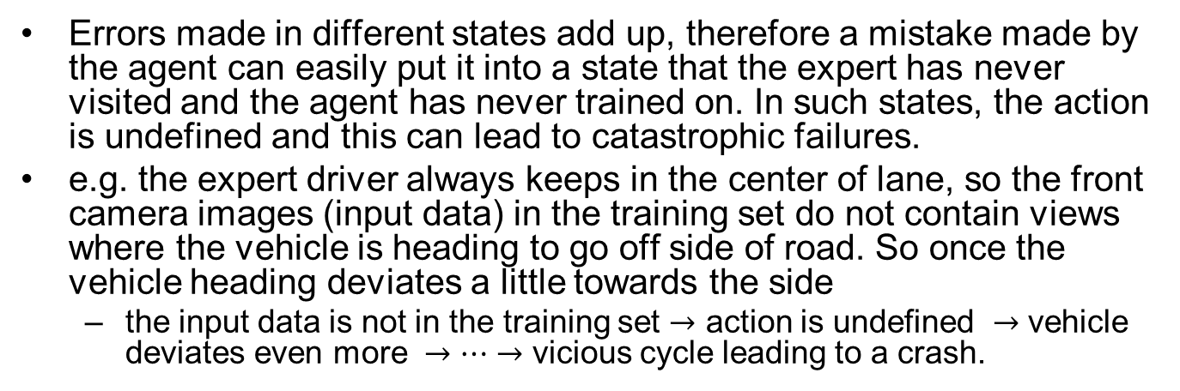
Distributional Shift in IL/BC
Errors made in different states add up, therefore a mistake made by the agent can easily put it into a state that the expert has never visited and the agent has never trained on. In such states, the action is undefined and this can lead to catastrophic failures.
e.g. the expert driver always keeps in the center of lane, so the front camera images (input data) in the training set do not contain views where the vehicle is heading to go off side of road. So once the vehicle heading deviates a little towards the side
the input data is not in the training set $→$ action is undefined $→$ vehicle deviates even more $→…→$ vicious cycle leading to a crash.
https://medium.com/@SmartLabAI/a-brief-overview-of-imitation-learning-8a8a75c44a9c

Slide 13
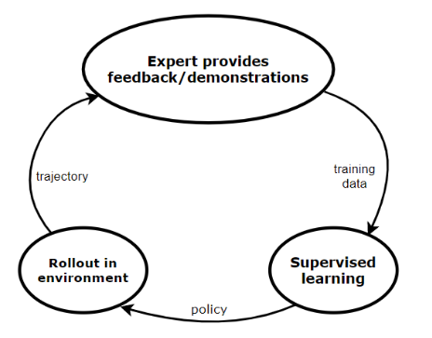
Direct Policy Learning (DPL)
DPL is an improved version of behavioral cloning. Assuming that we have access to an interactive expert at training time,
First, we start with an initial predictor policy based on the initial expert demonstrations.
Then, we execute a loop until we converge. In each iteration, we collect trajectories by rolling out the current policy (which we obtained in the previous iteration) and using these we estimate the state distribution.
Then, for every state, we collect feedback from the expert (what would have he done in the same state).
Finally, we train a new policy using this feedback.
Notes:
who we can query. Just like in BC, we collect some demonstrations from the expert, and we apply SL to learn a policy. We roll out this policy in our environment, and we query the expert to evaluate the roll-out trajectory. In this way, we get more training data, which we feedback to SL. This loop continues until we converge.

Slide 14
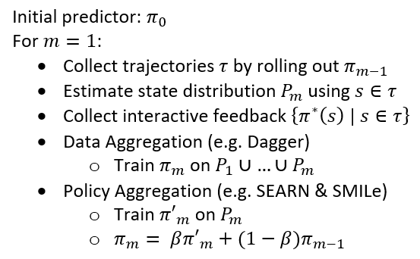
TODO Two Variants of DPL
Data Aggregation trains the actual policy on all the previous training data.
e.g., Dagger: expert remains in the loop during the training of the controller: the controller is iteratively tested and samples from the obtained trajectories are re-labeled by the expert
Policy Aggregation trains a policy on the training data received on the last iteration and then combines this policy with all the previous policies using geometric blending. In the next iteration, we use this newly obtained, blended policy during the roll-out

Slide 15
Inverse Reinforcement Learning (IRL)
Start with a set of expert’s demonstrations (we assume these are optimal) and then try to estimate the parameterized reward function, that would cause the expert’s behavior/policy.
Problem: reward function is not unique, multiple reward functions may lead to the same behavior.
e.g., an outside observer sees that you work very hard (behavior). He may infer your reward function to be “maximize WorkTime” (since you really enjoy your job). But your actual reward function is “maximize MoneyEarned” (while you really hate your job).
An agent with incorrect value function won’t generalize well in a different environment. Suppose someone trains an agent to imitate you. The agent has the same behavior as you in the current environment, but faced with a job offer with higher salary, the agent may take a different action than you.
Solution: try to learn the correct value function by observing the expert in diverse environments.

Slide 16
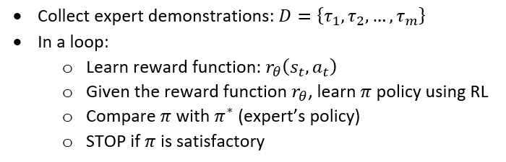
IRL Details
Repeat until we find a good enough policy:
Update the reward function parameters.
Solve the RL problem to find the optimal policy.
Compare the newly learned policy with the expert’s policy.

Slide 17
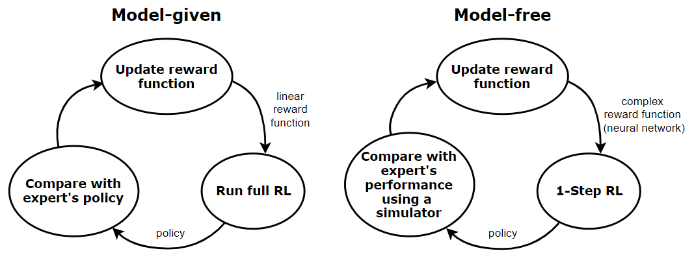
Two Variants of IRL
Not covered in exam
In the model-given case, our reward function is linear. In each iteration, we need to solve the full RL problem (only feasible for small MDP’s). We know the model (state transition dynamics of the environment), so we can easily compare our learned policy with the expert’s one.
The model-free approach is a more general case. Here, we assume that the reward function is more complex (e.g., modeled with a DNN). We also suppose that the state space of the MDP is large or continuous, therefore in each iteration, we only solve a single step of the RL problem. We don’t know the model, but we have access to a simulator of the environment. Therefore, comparing our policy to the expert’s one is trickier.

Slide 18
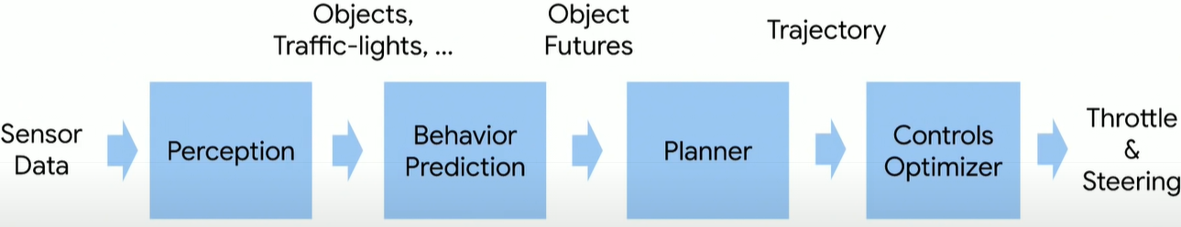
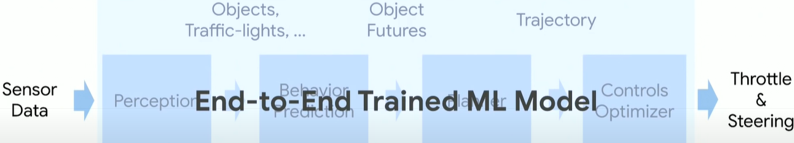
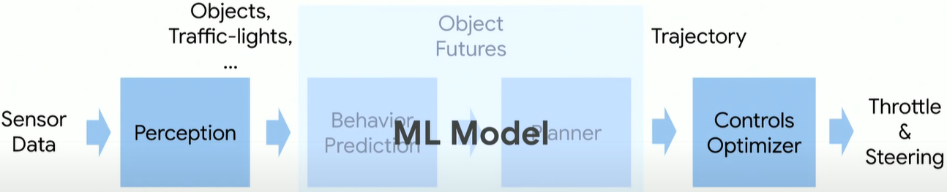
Classic Pipeline
End-to-End Driving (NVIDIA’s PilotNet)
Mid-to-Mid Driving (Waymo’s ChauffeurNet)

Slide 19
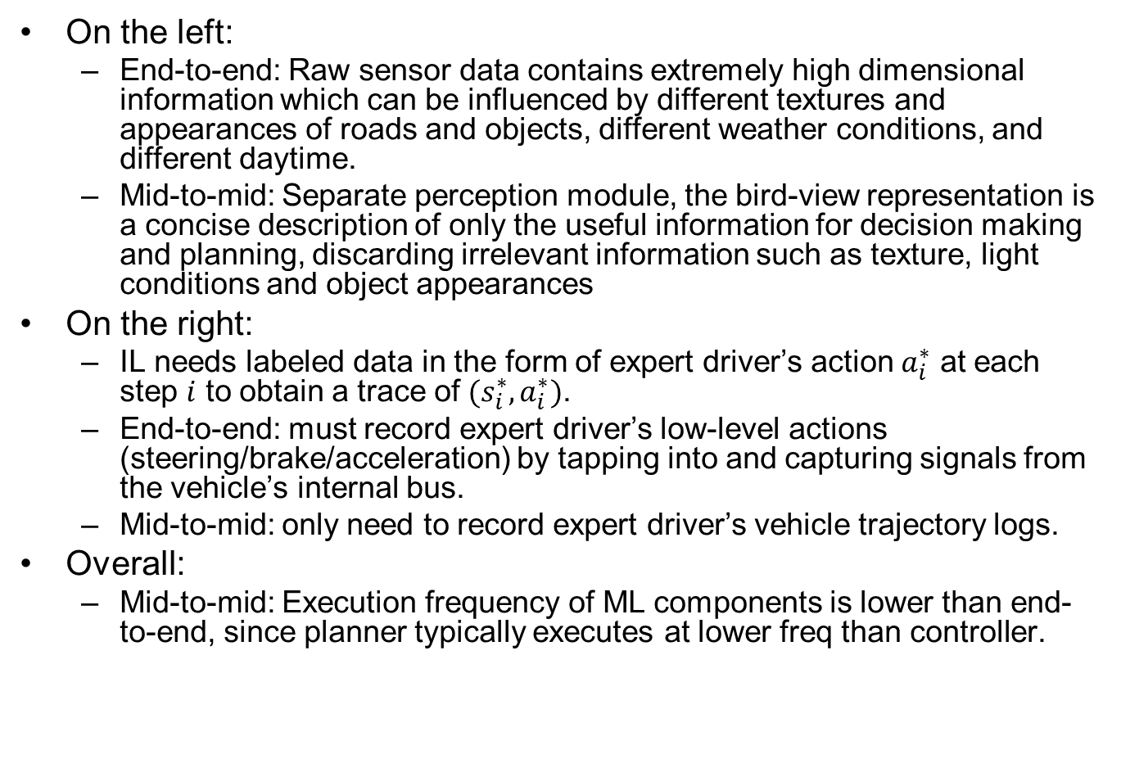
Advantages of Mid-to-Mid
On the left:
End-to-end: Raw sensor data contains extremely high dimensional information which can be influenced by different textures and appearances of roads and objects, different weather conditions, and different daytime.
Mid-to-mid: Separate perception module, the bird-view representation is a concise description of only the useful information for decision making and planning, discarding irrelevant information such as texture, light conditions and object appearances
On the right:
IL needs labeled data in the form of expert driver’s action $a_{i}^{∗}$ at each step $i$ to obtain a trace of $(s_{i}^{∗},a_{i}^{∗})$.
End-to-end: must record expert driver’s low-level actions (steering/brake/acceleration) by tapping into and capturing signals from the vehicle’s internal bus.
Mid-to-mid: only need to record expert driver’s vehicle trajectory logs.
Overall:
Mid-to-mid: Execution frequency of ML components is lower than end-to-end, since planner typically executes at lower freq than controller.
Notes:
generates bird-view representation, which helps simplify the visual information while maintaining useful information for driving.

Slide 20
Early Projects of IL (BC) Applied to AD
ALVINN
CMU, 1990
Low-res image as input
Fully connected NN
DAVE
Muller, LeCun, 2003
Low-res image as input
CNN

Slide 21
PilotNet [Bojarski 2016]
Bojarski M, Del Testa D, Dworakowski D, et al. End to end learning for self-driving cars[J]. arXiv preprint arXiv:1604.07316, 2016.
End-to-End Driving (NVIDIA’s PilotNet)
Notes:
Bojarski M, Del Testa D, Dworakowski D, et al. End to end learning for self-driving cars[J]. arXiv preprint arXiv:1604.07316, 2016.
https://arxiv.org/abs/1604.07316

Slide 22
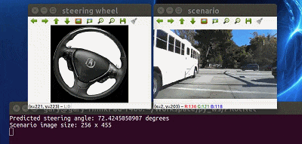
Training Method
End-to-End model trained with Imitation Learning (BC)
Human drives vehicle
Record sensor data and human actuator commands as training pairs
Train a DNN to map sensor data to actuator commands, mimicking a human. (PilotNet controls steering only. I think acceleration/braking are controlled separately, but the paper did not say how.)
PilotNet driving video:
https://www.youtube.com/watch?v=_N7nC-8YxzE
https://github.com/lhzlhz/PilotNet
Notes:
: End to End Learning for Self-Driving Cars

Slide 23
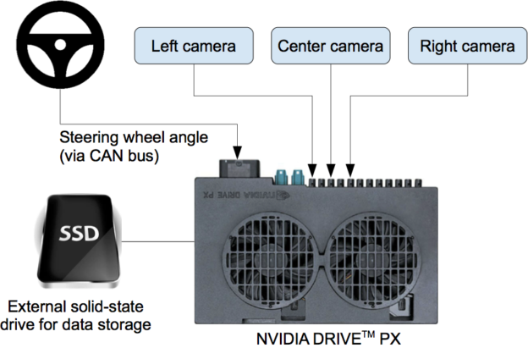
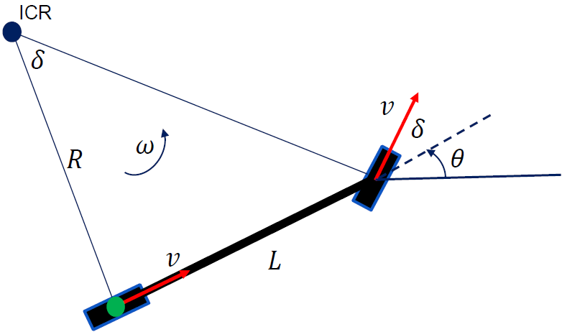
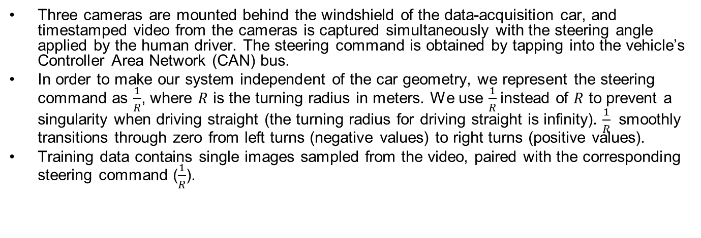
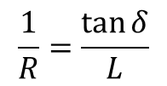
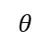
Data Collection System
Three cameras are mounted behind the windshield of the data-acquisition car, and timestamped video from the cameras is captured simultaneously with the steering angle applied by the human driver. The steering command is obtained by tapping into the vehicle’s Controller Area Network (CAN) bus.
In order to make our system independent of the car geometry, we represent the steering command as $\frac{1}{R}$, where $R$ is the turning radius in meters. We use $\frac{1}{R}$instead of $R$ to prevent a singularity when driving straight (the turning radius for driving straight is infinity). $\frac{1}{R}$ smoothly transitions through zero from left turns (negative values) to right turns (positive values).
Training data contains single images sampled from the video, paired with the corresponding steering command ($\frac{1}{R}$).
$$\frac{1}{R}=\frac{\tan{δ}}{L}$$
$$θ$$
https://devblogs.nvidia.com/deep-learning-self-driving-cars/

Slide 24
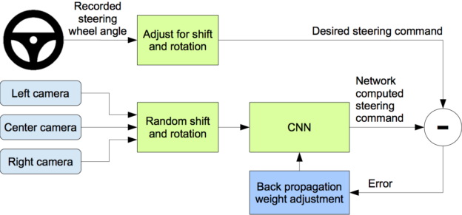
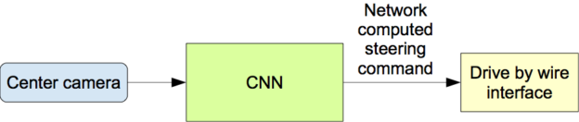
Training Data Augmentation
Problem: training data from human driver always stays in center of lane. So if car deviates from center, the image it sees is not in the training set, so it does not know the correct action.
Solution: Augment training data with additional images that show the car in different shifts from the center of the lane and rotations from the direction of the road. The images for two specific off-center shifts can be obtained from the left and the right cameras.
Training
Operation
Notes:
The training
data is therefore augmented with additional images that show the car in different shifts from the
center of the lane and rotations from the direction of the road.

Slide 25
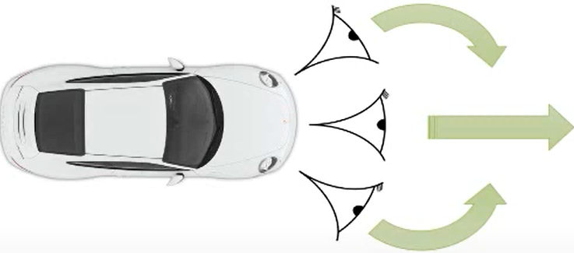
Training Data Augmentation Details
We augment the data by adding artificial shifts and rotations to teach the network how to recover from a poor position or orientation.
Images for two specific off-center shifts can be obtained from the left and the right camera. Additional shifts between the cameras and all rotations are simulated by viewpoint transformation of the image from the nearest camera. The steering label for transformed images is adjusted to one that would steer the vehicle back to the desired location and orientation in two seconds.
Ex.: Image from center camera shows car is driving straight; Shifted image from left camera shows car is leaning left. Associate this image with synthetic “turn right” command (even though human driver never issued it). During operation, if the center camera sees this image, issue “turn right” command.
Notes:
Precise viewpoint transformation requires 3D scene knowledge which we don’t have. We therefore approximate the transformation by assuming all points below
the horizon are on flat ground and all points above the horizon are infinitely far away. This works
fine for flat terrain but it introduces distortions for objects that stick above the ground, such as cars,
poles, trees, and buildings. Fortunately these distortions don’t pose a big problem for network training.

Slide 26
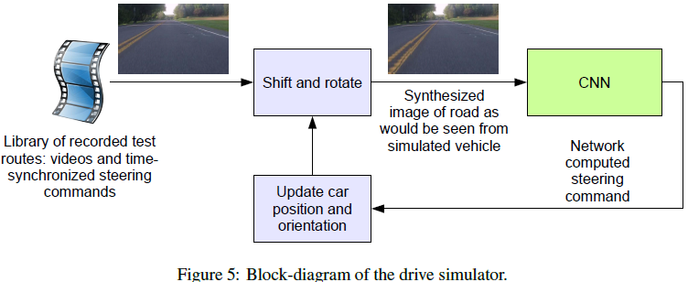
Driving Simulator
The simulator transforms the original images to account for departures from the ground truth. The magnitude of these perturbations is chosen randomly from a normal distribution.

Slide 27
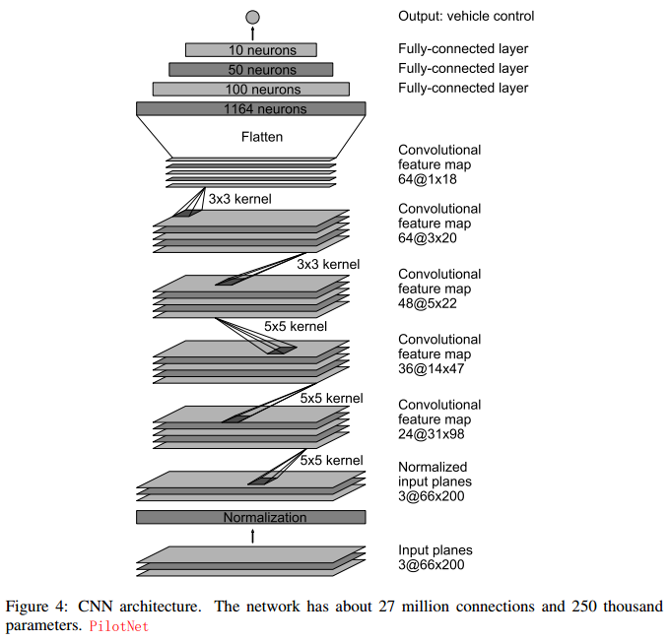
PilotNet
~250K distinct weights
~27M connections

Slide 28
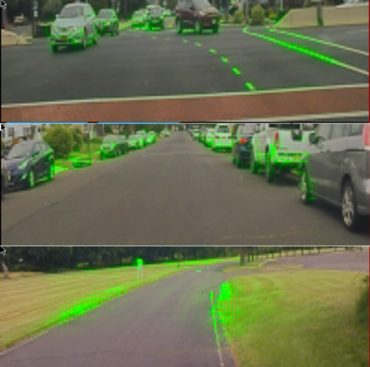
Visualization of Salient Objects
The visualization shows which regions of the input image contribute most to the output of the network. These regions identify the salient objects (highlighted in green).
PilotNet focuses on the same things a human driver would, including lane markers, road edges and other cars.
https://blogs.nvidia.com/blog/2017/04/27/how-nvidias-neural-net-makes-decisions/
Bojarski M, Yeres P, Choromanska A, et al. Explaining how a deep neural network trained with end-to-end learning steers a car[J]. arXiv preprint arXiv:1704.07911, 2017.
Notes:
Visualization, overlaid on an image of what the car’s camera recorded. Everything in green is a high priority focus point for the network.

Slide 29
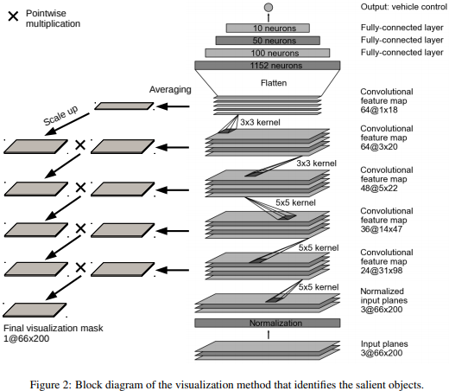
Visualization Method
Not covered in exam

Slide 30
On-Road Tests
After a trained network has demonstrated good performance in the simulator, the network is loaded on the DRIVE PX in our test car and taken out for a road test.
For a typical drive in Monmouth County NJ from our office in Holmdel to Atlantic Highlands, we are autonomous approximately 98% of the time. We also drove 10 miles on the Garden State Parkway (a multi-lane divided highway with on and off ramps) with zero intercepts.
Notes:
For these tests we measure performance
as the fraction of time during which the car performs autonomous steering. This time
excludes lane changes and turns from one road to another.

Slide 31
Chauffeurnet [Bansal 2018]
Bansal M, Krizhevsky A, Ogale A. Chauffeurnet: Learning to drive by imitating the best and synthesizing the worst[J]. arXiv preprint arXiv:1812.03079, 2018.
Mid-to-Mid Driving (Waymo’s ChauffeurNet)
https://medium.com/waymo/learning-to-drive-beyond-pure-imitation-465499f8bcb2
Notes:
Learning to Drive: Beyond Pure Imitation
Waymo Team, 2018 Bansal, Mayank, Alex Krizhevsky, and Abhijit Ogale. "Chauffeurnet: Learning to drive by imitating the best and synthesizing the worst." arXiv preprint arXiv:1812.03079 (2018). https://arxiv.org/pdf/1812.03079.pdf

Slide 32
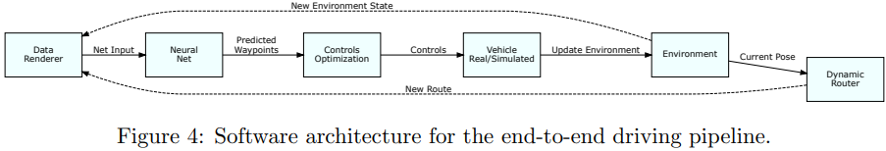
Abstract
Our goal is to train a policy for autonomous driving via imitation learning that is robust enough to drive a real vehicle. We find that standard behavior cloning is insufficient for handling complex driving scenarios, even when we leverage a perception system for preprocessing the input and a controller for executing the output on the car: 30 million examples are still not enough.
Training data: 30 million real-world expert driving examples, corresponding to about 60 days of continual driving
We propose exposing the learner to synthesized data in the form of perturbations to the expert’s driving, which creates interesting situations such as collisions and/or going off the road.
Rather than purely imitating all data, we augment the imitation loss with additional losses that penalize undesirable events and encourage progress – the perturbations then provide an important signal for these losses and lead to robustness of the learned model.

Slide 33
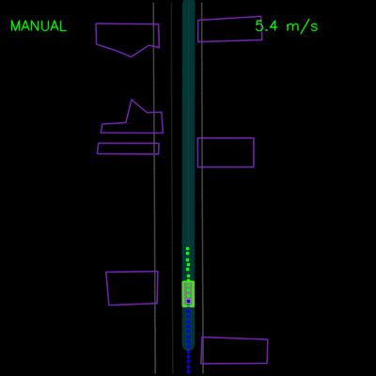
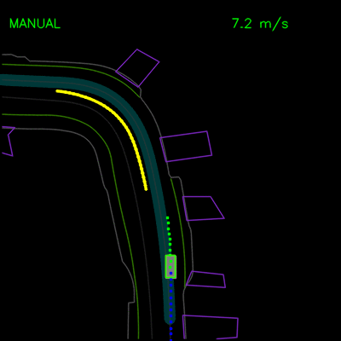
BC Experiments
Agent trained with pure BC gets stuck behind a parked vehicle (left) and is unable to recover from a trajectory deviation while driving along a curved road (right). The teal path depicts the input route, yellow box is a dynamic object in the scene, green box is the agent, blue dots are the agent’s past positions and green dots are the predicted future positions.

Slide 34


ChauffeurNet Experiments
ChauffeurNet model can now successfully nudge around the parked vehicle (left) and recover from the trajectory deviation to continue smoothly along the curved road (right).

Slide 35
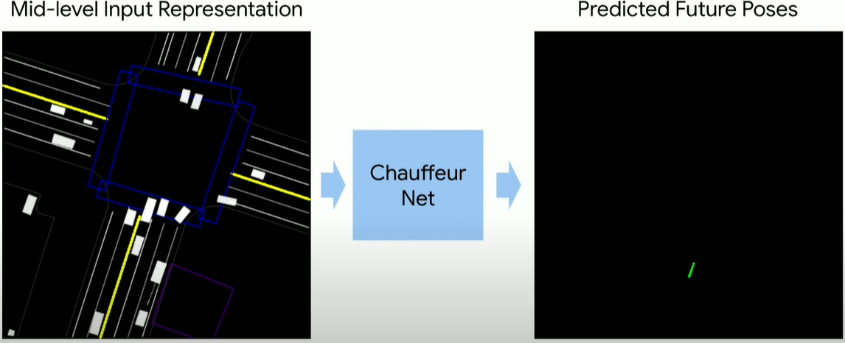
ChauffeurNet Input/Output
We use a perception system that processes raw sensor information and produces our input: a top-down representation of the environment and intended route, where objects such as vehicles are drawn as oriented 2D boxes along with a rendering of the road information and traffic light states. We present this mid-level input to a recurrent neural network (RNN), named ChauffeurNet, which then outputs a driving trajectory that is consumed by a controller which translates it to steering and acceleration.

Slide 36
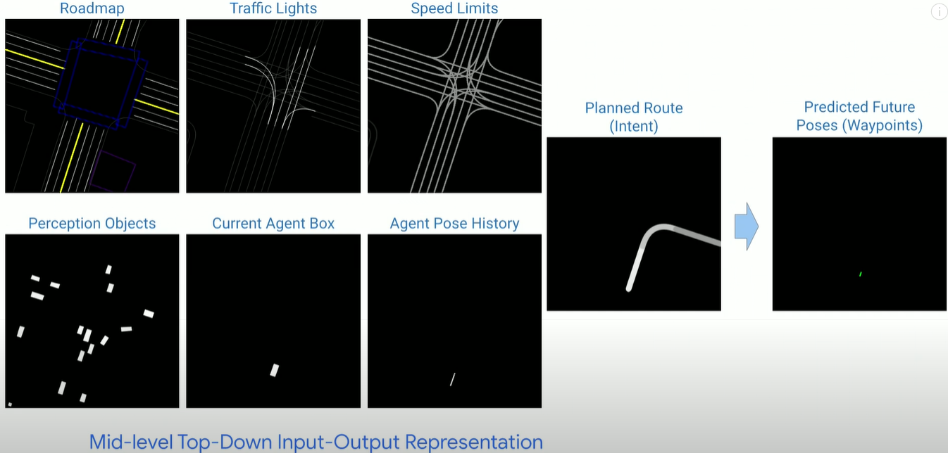
ChauffeurNet Input/Output in Detail

Slide 37
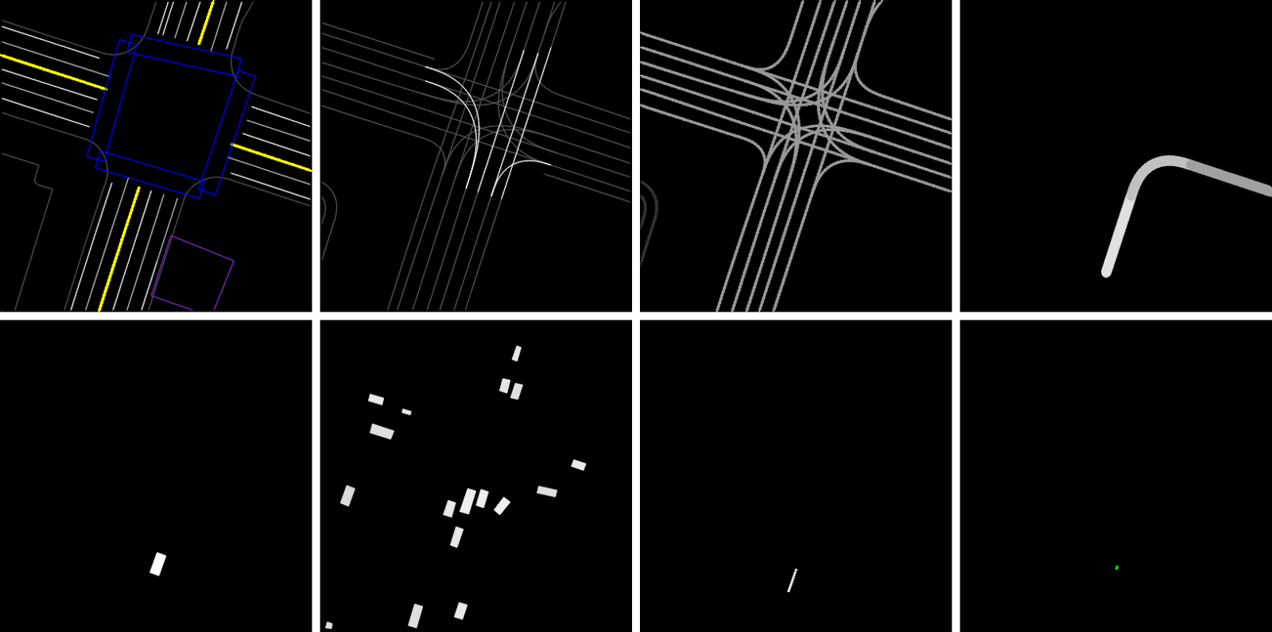
Rendered inputs and outputs
Output
Top-row left-to-right: Roadmap, Traffic lights (bright lines denote red light), Speed-limit, and Planned Route (intent: ego-car should turn right).
Bottom-row left-to-right: Current Agent Box, Dynamic Boxes (history of past 1-2s), Past Agent Poses, and the output Future Agent Poses (shown in last slide).

Slide 38
ChauffeurNet Architecture
ChauffeurNet is a Convolutional Recurrent Neural Network (RNN), consisting of the CNN FeatureNet, and the AgentRNN.
Trained with IL, guided by ground truth data (green) and loss functions (blue)
26M examples from real driving logs
Compare to PilotNet
PilotNet uses CNN to map from current camera image to steering angle, no history info is use.
ChauffeurNet uses RNN, and exploits the history (past agent location and past prediction for a few seconds) to make better predictions and decisions.

Slide 39
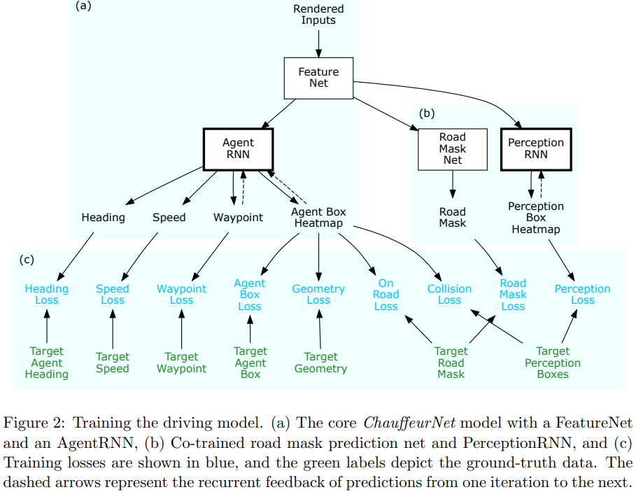
Not covered in exam

Slide 40
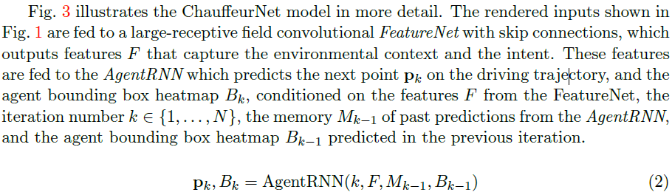
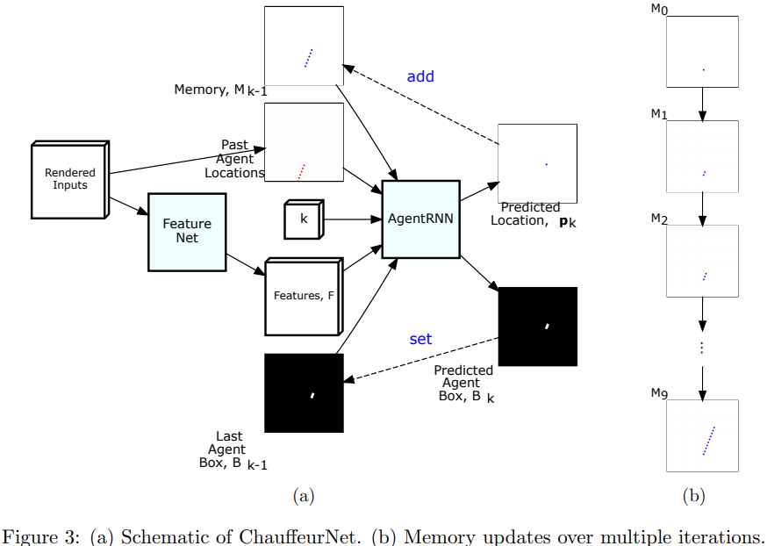
ChauffeurNet Details
Not covered in exam
Notes:
The AgentRNN consumes
1) an image with a rendering of the past agent poses,
2) a set of features computed by a convolutional network “FeatureNet” from the rendered inputs,
3) an image with the last agent box rendering,
4) an explicit memory with a rendering of the predicted future agent poses to predict the next agent pose and the next agent box in the top-down view. (memory is not learned but hand-crafted)
These predictions are used to update the inputs to the AgentRNN for predicting the next timestep
Each iteration predicts the next waypoint conditioned on all previously predicted waypoints and input data.

Slide 41
Beyond Pure Imitation
Synthesizing Perturbations
Beyond the Imitation Loss
Collision Loss
On Road Loss
Geometry Loss
Auxiliary Losses
Imitation Dropout

Slide 42
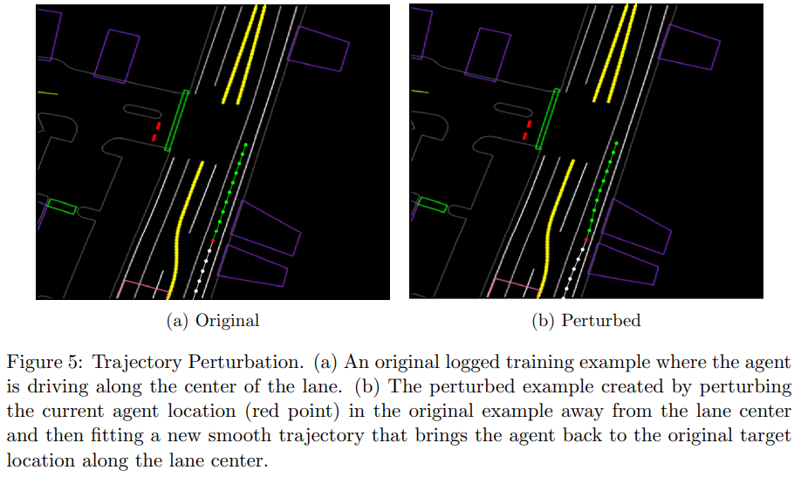
Trajectory Perturbation
Running the model as a part of a closed-loop system over time can cause the input data to deviate from the training distribution. To prevent this, we train the model by adding some examples with realistic perturbations to the agent trajectories.
Notes:
Domain Randomization w.
Randomized heading offsetsThe start and end of a trajectory are kept constant, while a perturbation is applied around the midpoint and smoothed across the other points. Quantitatively, we jitter the midpoint pose of the agent uniformly at random in the range [−0.5, 0.5] meters in both axes, and perturb the heading by [−π/3, π/3] radians. We then fit a smooth trajectory to the perturbed point and the original start and end points. Such training examples bring the car back to its original trajectory after a perturbation.

Slide 43
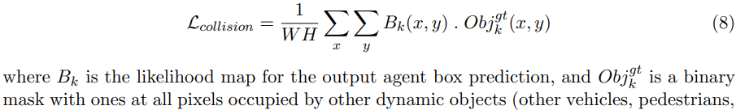

Collision Loss
Since our training data does not have any real collisions, the idea of avoiding collisions is implicit and will not generalize well. To alleviate this issue, we add a specialized loss that directly measures the overlap of the predicted agent box $B_{k}$ with the ground-truth boxes of all the scene objects at each timestep
(Details of On Road Loss, Geometry Loss, Auxiliary Losses omitted.)

Slide 44

Imitation Dropout
Not covered in exam

Slide 45


Slide 46
IL with Safety [Chen 2019]
Chen J, Yuan B, Tomizuka M. Deep imitation learning for autonomous driving in generic urban scenarios with enhanced safety[J]. arXiv preprint arXiv:1903.00640, 2019.

Slide 47
Abstract
The decision and planning system for AD in urban environments is hard to design. Most current methods are to manually design the driving policy, which can be sub-optimal and expensive to develop and maintain at scale. Instead, with imitation learning we only need to collect data and then the computer will learn and improve the driving policy automatically. However, existing imitation learning methods for autonomous driving are hardly performing well for complex urban scenarios. Moreover, the safety is not guaranteed when we use a DNN policy. In this paper, we proposed a framework to learn the driving policy in urban scenarios efficiently given offline collected driving data, with a safety controller incorporated to guarantee safety at test time. The experiments show that our method can achieve high performance in realistic three-dimensional simulations of urban driving scenarios, with only hours of data collection and training on a single consumer GPU.

Slide 48

Framework Overview
The agent takes information from the perception and routing modules, generates a bird-view image and outputs the planned trajectory using a DNN policy network. The safety & tracking controller then calculates the safe control command to be applied to the ego vehicle in the driving environment
Notes:
The deep imitation learning trajectory
planner is responsible to handle almost everything about driving
intelligence, such as how to follow the given routing in
various road conditions, how to react to surrounding objects,
and how to handle different traffic light states. This module is
learned end-to-end from the perception results to the planned
trajectory. The safety & tracking controller is responsible to
guarantee safety and handle vehicle dynamics.

Slide 49


Deep Imitation Learning
DNN output is future trajectory in a preview horizon $H$: $[x_{t+1},y_{t+1},…,x_{t+H},y_{t+H}]$, which is tracked by a low-level controller (PID, MPC).
Notes:
To make the learned policy generalize well, the dataset needs to cover enough data for each dimension of sensor information such as texture, weather, light conditions and object appearances.

Slide 50

DNN Architecture & Loss Function
Based on CNN (VGGNet16). Output layer has $H$units corresponding to $H$ predicted trajectory points $\left({\hat{x}}_{t+i}, {\hat{y}}_{t+i}\right), i∈[1,H]$.
Loss function to be minimized:
$L_{t}=\frac{1}{H}\sum_{i=1}^{H}{d_{t+i}^{2}}$
where displacement error $d_{t+i}$ between the expert’s motion trajectory point position $(x_{t+i}, y_{t+i})$ and the predicted point position $({\hat{x}}_{t+i}, {\hat{y}}_{t+i})$: $d_{t+i}={\left({\left(x_{t+i}−{\hat{x}}_{t+i}\right)}^{2}+{\left(y_{t+i}−{\hat{y}}_{t+i}\right)}^{2}\right)}^{\frac{1}{2}}$
Notes:
in The overall loss function is defined as
(vs. ConvRNN in ChauffeurNet)
the ego vehicle local coordinate

Slide 51
Data Collection and Augmentation
Based on CARLA simulator.
At data collection phase, we use a model-based controller to act as the expert. The controller is same as other agents, which performs normal urban driving behaviors and make random turns at intersections. When ego vehicle is running, we record the rendered bird-view images and the corresponding ego vehicle states (global positions and yaw angle) every 0.1 second.
We introduce control noise to the expert controller during the data collection phase, and let the expert recover from the perturbation. The control noise is added periodically every 8 seconds, and will last for 1 second. The vehicle’s pose might be pushed away from the way points. The expert then provides demonstrations of recovering from perturbations. The states during the noise phase are removed in order not to contaminate the dataset

Slide 52

Trajectory Tracking Controller
Given the planned future trajectory $[{\hat{x}}_{t+1},{\hat{y}}_{t+1},…,{\hat{x}}_{t+H},{\hat{y}}_{t+H}]$, the tracking controller outputs the desired acceleration $a_{t}$ and steering angle $δ_{t}$ to drive the vehicle to follow the trajectory. A way point $({\hat{x}}_{t+m},{\hat{y}}_{t+m})$ is selected with $m∈[1,H−1]$ (we pick $m=5$ here).
At any time instant $t$, aim for the 5th point $({\hat{x}}_{t+5},{\hat{y}}_{t+5})$ on the planned trajectory
Decomposed into longitudinal controller and lateral controller, both PID controllers.

Slide 53

Longitudinal Controller
Not covered in exam
Target speed is set to be:
$v_{d}=\frac{1}{dt}{\left\|\left({\hat{x}}_{t+m+1},{\hat{y}}_{t+m+1}\right)−\left({\hat{x}}_{t+m},{\hat{y}}_{t+m}\right)\right\|}_{2}$
Where $dt$ is the time interval between two subsequent time steps.
The desired acceleration is obtained using PID control to minimize speed tracking error
$e_{v}\left(t\right)=v_{d}−v(t)$
where $v(t)$ is current speed of ego vehicle.

Slide 54


Lateral Controller
Not covered in exam
The normal vector from the ego vehicle position to the target way point is
$n_{target}=\frac{\left({\hat{x}}_{t+m},{\hat{y}}_{t+m}\right)}{{\left\|\left({\hat{x}}_{t+m},{\hat{y}}_{t+m}\right)\right\|}_{2}}$
The normal vector of the ego vehicle heading is
$n_{ego}=(\cos{θ_{t}},\sin{θ_{t}})$
where $θ_{t}$ is the heading angle of the ego vehicle
Then the desired steering angle is obtained using PID control to minimize the heading error:
$e_{yaw}\left(t\right)=\cos^{−1}{(n_{ego}\left(t\right)⋅n_{ego}\left(t\right))}$
Recall vector dot product: $x⋅y=\left\|x\right\|\left\|y\right\|\cos{θ}$
https://en.wikipedia.org/wiki/Dot_product
Notes:
$$n_{target}$$
$$n_{ego}$$

Slide 55

Safety Enhancement Controller
Not covered in exam
The acceleration and steering command $\left[\begin{matrix}a_{t} \\ δ_{t}\end{matrix}\right]$ calculated by the trajectory tracking controller does not guarantee safety, e.g, no collisions to other agents.
Safety controller for collision avoidance will modify $\left[\begin{matrix}a_{t} \\ δ_{t}\end{matrix}\right]$to enhance safety, if their original values are not safe.
The safe set algorithm: for each time step $t$, calculate a control safe set $U_{S}(t)$, s.t. if control command $u\left(t\right)=\left[\begin{matrix}a_{t} \\ δ_{t}\end{matrix}\right]∈U_{S}(t)$, the ego vehicle would stay safe.
Notes:
DNN policy network may be unreliable
Tracking

Slide 56




Safety Index
Not covered in exam
Safety index $φ\left(x\right)$: function of vehicle state $x$, which includes states (position, velocity, heading) of both ego vehicle ($x_{0}$) and a surrounding object ($x_{j}$). The system is considered safe if $φ\left(x\right)≤0∧d≥0$, and unsafe otherwise.
$φ\left(x\right)=D−d^{2}\left(x\right)−α\dot{d}\left(x\right)$
where $d\left(x\right)=\sqrt{{\left[p_{0}−p_{j}\right]}^{T}Q\left[p_{0}−p_{j}\right]}$ is shaped distance between ego vehicle and surrounding vehicle. $p_{0}$ indicates position of ego vehicle, and $p_{j}$ indicates position of the surrounding object. $Q$ is a $2×2$ matrix s.t. ${\left[p_{0}−p_{j}\right]}^{T}Q\left[p_{0}−p_{j}\right]=1$ encodes an ellipse around the surrounding vehicle with long axis equal to 1 and short axis equal to $\frac{1}{β}$, where $β$ is the aspect ratio of the ellipse. $α$ is a tunable parameter.
$D^{2}$ should be $D$
Notes:
Zgu: I think should be D^2, not D
The Robustly-Safe Automated Driving System for Enhanced Active Safety, Changliu Liu[1], Jianyu Chen[1], Trong-Duy Nguyen[2] and Masayoshi Tomizuka 2017

Slide 57




Safety Index Illustration
Not covered in exam
$φ\left(x\right)=D−d^{2}\left(x\right)−α\dot{d}\left(x\right)$
$φ\left(x\right)≤0⇒d^{2}\left(x\right)+α\dot{d}\left(x\right)≥D$
The larger the distance $d(x)$, the larger relative speed $\dot{d}\left(x\right)$ (positive speed means moving away from each other), the safer it is.

Slide 58


State Safe Set and Control Safe Set
Not covered in exam
State safe set $X_{S}$: level set of the safety index
$X_{S}=\left\{x:φ\left(x\right)≤0\right\}=\{x:d^{2}\left(x\right)+α\dot{d}\left(x\right)≥D\}$
It injects an ellipse constraint as shown in Fig. 3, also considering the relative speed between the ego and surrounding object.
Control safe set
$U_{S}(t)=\left\{u\left(t\right):\dot{φ}≤−η if φ≥0\right\}$ where $η>0$ is some margin. It is easy to prove that if $x\left(0\right)∈X_{S}∧u\left(t\right)∈U_{S}$ for $t≥0$, then $x\left(t\right)∈X_{S}$
If we approximate ego vehicle dynamics to a control affine function $\dot{x_{0}}=f\left(x_{0}\right)+Bu$, the control safe set can be written as:
$U_{S}(t)=\{u\left(t\right):L\left(t\right)u\left(t\right)≤S\left(t\right) if φ≥0\}$
where $L\left(t\right)=\frac{∂φ}{∂x_{0}}B, S\left(t\right)=η−\frac{∂φ}{∂x_{j}}{\dot{x}}_{j}−\frac{∂φ}{∂x_{0}}f$
Derivation: $\dot{φ}\left(x\right)=\frac{∂φ}{∂x_{0}}{\dot{x}}_{0}+\frac{∂φ}{∂x_{j}}{\dot{x}}_{j}=\frac{∂φ}{∂x_{0}}\left(f+Bu\right)+\frac{∂φ}{∂x_{j}}{\dot{x}}_{j}≤η$
If there are multiple surrounding objects, we can calculate the intersection of the control safe set for each object, which is a convex polytope, denoted as $U_{S}\left(t\right).$
Paper contains typos:
Notes:
, so that if their relative speed is high, it is more likely to be unsafe
$$φ\left(x\right)=D−d^{2}\left(x\right)−α\dot{d}\left(x\right)$$
$d\left(x\right)=\sqrt{{\left[p_{0}−p_{j}\right]}^{T}Q\left[p_{0}−p_{j}\right]}$

Slide 59

Safe Control Command
Not covered in exam
Control command $u\left(t\right)=\left[\begin{matrix}a_{t} \\ δ_{t}\end{matrix}\right]$ from the trajectory tracking controller may be unsafe. The safety controller maps it into the control safe set $U_{S}$ by solving Quadratic Programming (QP) problem, to stay in $U_{S}$ while minimizing its deviation from the potentially unsafe $u\left(t\right)$:
$u^{∗}\left(t\right)={argmin}_{u∈U_{S}}{\frac{1}{2}{\left[u−u(t)\right]}^{T}W\left[u−u(t)\right]}$
where $W$ is a $2×2$ weight matrix
We thus obtain the modified safe control command $u^{∗}\left(t\right)=\left[\begin{matrix}a_{t}^{∗} \\ δ_{t}^{∗}\end{matrix}\right]$.
Notes:
, tracked by the low-level controller that maps it to steering torque,

Slide 60
Conditional IL (CIL) [Codevilla 2018]
Codevilla, Felipe, et al. "End-to-end driving via conditional imitation learning." 2018 IEEE International Conference on Robotics and Automation (ICRA). IEEE, 2018.

Slide 61

Standard IL Limitations
Standard IL: training data is a set of observation-action pairs $D{\left\{\left\langle o_{i},a_{i}\right\rangle \right\}}_{i=1}^{N}$ generated by expert. We train a function (DNN) to mimic expert actions $a_{i}$
$\min_{θ}{\sum_{i}{l(F\left(o_{i};θ\right),a_{i})}}$ (Note different notations: here $o_{i}$ is the same as state $s_{i}$ we saw before, e.g., video captured by front camera.)
An implicit assumption of this formulation is that the expert’s actions are fully explained by the observations; that is, there exists a function $E$ that maps observations to the expert’s actions: $a_{i}=E(o_{i})$
IL works well if this assumption holds, e.g., for lane following. However, in more complex scenarios the assumption breaks down. Consider a driver approaching an intersection. His subsequent actions are not explained by his observations, but are additionally affected by his intention (do I want to turn left, go straight or turn right?). The same observations could lead to different actions, depending on this intention.
Notes:
We first explicit model the expert’s internal state by a vector $h$, which together with the observation explains the expert’s action: $a_{i}=E(o_{i},h_{i})$. Vector $h$ can include information about the expert’s intentions, goals, and prior knowledge
$\min_{θ}{\sum_{i}{l(F\left(o_{i};θ\right),E(o_{i},h_{i}) )}}$

Slide 62


Command Conditional IL
At training time, command $c$ is provide by expert, e. g., go (left, straight, right) a few seconds before reaching next intersection.
e.g., human drivers already use turn signals to communicate their intention when approaching intersections; these turn signals can be used as commands.
The training dataset becomes $D{\left\{\left\langle o_{i},c_{i},a_{i}\right\rangle \right\}}_{i=1}^{N}$. Command-conditional IL objective $\min_{θ}{\sum_{i}{l(F\left(o_{i},c_{i} ;θ\right),a_{i})}}$
At test time, commands can come from a human user (passenger), or a high-level planning module (with A*, Dijkstra…). They affect behavior of the controller in two possible architectures.
(My comment: shouldn’t the high-level planner always be present in any AD system?)
ICRA 2018 Spotlight Video
https://www.youtube.com/watch?v=GNVHds_mvlg
Notes:
We expose the latent state $h$ to the controller by introducing an additional command input: $c = c\left(h\right)$ as an abstraction of
In urban driving, a typical command would be “turn right at the next intersection”, which can be provided by a navigation system or a passenger.
but if you rely on a human to give the condition, then it is not full AD; seems reasonable to rely on a high-level planning module to give condition or operator with remote control

Slide 63


Two Architectures
Each observation $o=\left\langle i,m\right\rangle$ comprises
Front camera image $i$
and a low-dimensional vector $m$ (e.g., car speed)
Action $a=\left\langle s,a\right\rangle$ (steering angle and acceleration)
Loss function for each sample: $l\left(a,a_{gt}\right)=l\left(\left\langle s,a\right\rangle ,\left\langle s_{gt},a_{gt}\right\rangle \right)={\left\|s−s_{gt}\right\|}^{2}+λ_{a}{\left\|a−a_{gt}\right\|}^{2}$ ($gt$ is ground truth from expert demo)
Left: Command $c$ is one of the inputs.
Right: Command $c$ acts as a switch.
CNN
FCN (Fully Connected Network)
Notes:
Zgu: is the loss function correct? It minimizes deviation from the entire input trace, including both state and action. Or should it minimize deviation of action corresponding to each state?
Left: Controller F is a DNN that takes the image $i$, the measurements $m$, and the command $c$ as inputs, and produces an action $a$ as its output. The action space is continuous and two-dimensional: steering angle and acceleration.
Right:
Is this loss function true for any IL?

Slide 64

Data Augmentation

Slide 65
Comparisons
View representation:
PilotNet and CIL [Codevilla18] use front camera view
ChauffeurNet and IL with Safety [Chen19] use bird-view representation, which helps simplify the visual information while maintaining useful information for driving.
Where DNN is used:
PilotNet and CIL are end-to-end.
ChauffeurNet and IL with Safety are mid-to-mid (DNN used for behavior prediction and planning to generate trajectory).
DNN Architecture
PilotNet, CIL and IL with Safety use CNN, input is current video frame only, with no history info.
I find it strange, as you can input a past history of N frames to capture recent history.
ChauffeurNet uses Convolutional RNN with an explicit memory, taking into account recent history.
CIL : adds a condition variable to help with the decision process at intersections.
IL with Safety has a safety controller that limits final control command to safe set.

